Slide 1
COST OF PRODUCTION

Slide 2



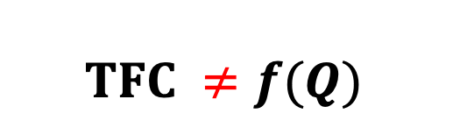

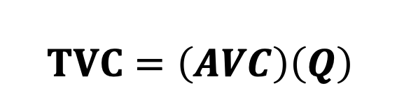
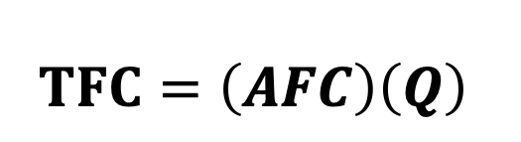

Short Run Costs
FIXED COSTS
VARIABLE COSTS
TOTAL FIXED COSTS (TFC)
TOTAL VARIABLE COSTS (TVC)
It is the total initial cost incurred in establishing the productive capacity
It is the total operational cost incurred in producing a given level of output
TVC
TVC
TFC
$$\left(A\right)$$
$$\left(B\right)$$
$$\left(C\right)$$
F
TFC
$$\left(a\right)$$
QTY
QTY
$$TFC=\left(AFC\right)\left(Q\right)$$
$$TVC=\left(AVC\right)\left(Q\right)$$
$$TFC ≠f(Q)$$
$$TVC=f(Q)$$
TFC curve has a vertical intercept
TVC curve begins at the origin

Slide 3




TPP
TPP
QL
TVC
TVC
$$\left(A\right)$$
$$\left(B\right)$$
$$\left(C\right)$$
$$\left(a\right)$$
QTY

Slide 4
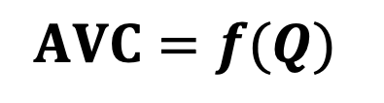
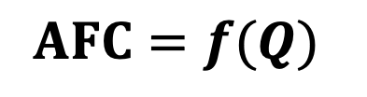


AVERAGE FIXED COSTS (AFC)
AVERAGE VARIABLE COSTS (AVC)
It is the Total Fixed Cost incurred per unit of the output produced
It is the Total Variable Cost incurred per unit of the output produced
AFC
AVC
AVC
AFC
QTY
QTY
$$AFC=\frac{TFC}{Q}$$
$$AVC=\frac{TVC}{Q}$$
$$AFC=f(Q)$$
$$AVC=f(Q)$$
AFC curve is :
A Rectangular Hyperbola
AVC curve is nearly ‘J’ shaped
An Asymptote

Slide 5




TPP
TPP
AVC
QL
AVC
$$\left(A\right)$$
$$\left(B\right)$$
$$\left(C\right)$$
$$\left(a\right)$$
QTY

Slide 6

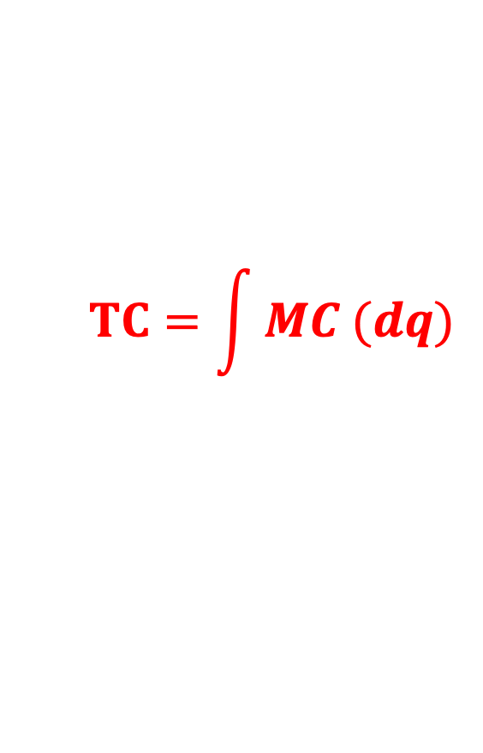
3 TOTAL COST
It is the overall Cost incurred in producing a given output level
$$TC=TFC+TVC$$
TC
TFC
TC
$$TC=\int{MC (dq)}$$
TVC
T₄
TC curve shares the vertical intercept with TFC;
i.e., TC curve starts at point F
T₃
TVC
T₂
V₄
T₁
TC curve is positioned by TFC
F₃= V₃
F₄
F
F₁
F₂
TFC
TC curve is shaped by TVC;
i.e., TVC’ = MC
V₁
V₂
TFC is gap between the TC and the TVC curves
Q₁
Q₂
Q₃
Q₄
Qty
(TC – TVC) = TFC = OF = T₁V₁ = T₂V₂ = T₃V₃ = T₄V₄

Slide 7

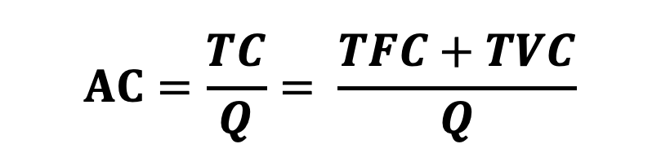

AVERAGE COSTS (AC)
MARGINAL COSTS (MC)
It is the Total Cost incurred per unit of the output produced
It is the change in Total Cost incurred by producing an additional unit of the output
AC
MC
MC
MC₁
AC
L
= Least Cost Point
Least Cost
M
QTY
Optimum Output
QTY
$$AC=\frac{TC}{Q}= \frac{TFC+TVC}{Q}$$
$$MC=\frac{d(TC)}{d(Q)}$$
$AC= \frac{TFC}{Q}+\frac{TVC}{Q}=AFC+AVC$
MC curve is nearly a ‘J’ shaped one
Its slopedness is indicative of the fixed factor’s efficiency
AC curve is nearly a ‘U’ shaped one
Efficiency of MC₁ > Efficiency of MC

Slide 8

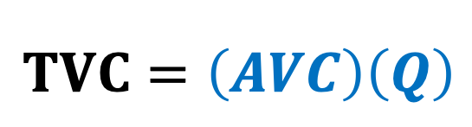

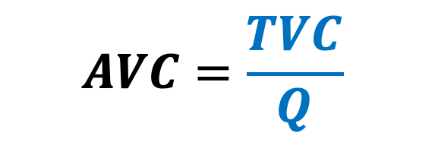

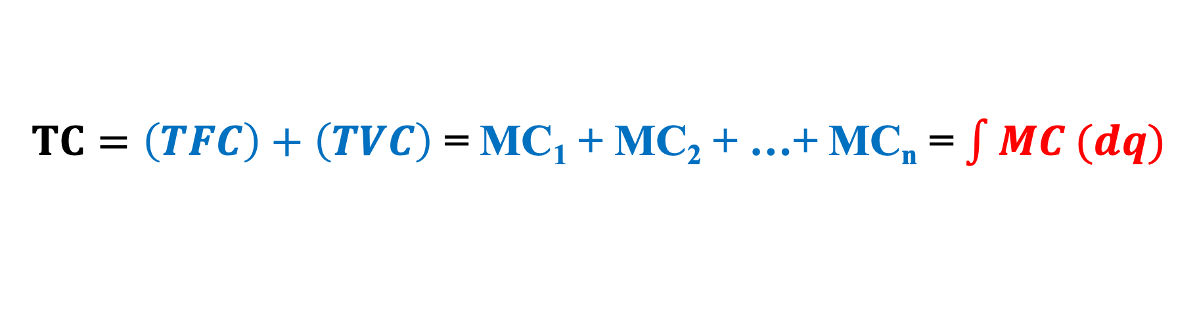
SHORT RUN COST FORMULAE (A Snap-Shot)
Fixed Cost
Variable Cost
$$TFC=\left(AFC\right)\left(Q\right)$$
$$TVC=\left(AVC\right)\left(Q\right)$$
Average Fixed Cost
Average Variable Cost
$$AFC=\frac{TFC}{Q}$$
$$AVC=\frac{TVC}{Q}$$
Total Cost
$TC=\left(TFC\right)+\left(TVC\right)$ = MC₁ + MC₂ + …+ MC_{n} = $\int{MC (dq)}$
Average Cost
$AC=ATC=\frac{\left(TC\right)}{\left(Q\right)}$ = $\frac{\left(TFC\right)+(TVC)}{\left(Q\right)}$ = AFC + AVC
Marginal Cost
$MC=\text{TC}\text{n}\text{ – }\text{TC}\text{(}\text{n}\text{−1)=}=\frac{d\left(TC\right)}{d\left(Q\right)}$

Slide 9
Relationship between AC, AVC and MC
AC
AVC
MC
AC
MC
AVC
QTY

Slide 10
Deliberations on
the shape of the AC Curve

Slide 11
Stage 1
Stage 2
AC
AVC
AFC
AC
AVC
AFC
Q2
Qty

Slide 12

AC
AVC
AFC
Stage 1
Stage 2
AC
AFC
AC = AFC + AVC
&
$$∴ ≈zero$$
AVC
Due to Internal Economies of Scale accruing to the firm, via the ‘M Freshness’ of the fixed factor
&
Q2
Qty

Slide 13

AC
AVC
AFC
Stage 1
Stage 2
AC
AC = AFC + AVC
AVC
$$≈zero$$
Because of Internal Diseconomies of Scale experienced by the firm, on a/c of the ‘M Fatigue and Exhaustion’ of the fixed factor
AFC
Q2
Qty

Slide 14
AC
AVC
AFC
Stage 1
Stage 2
AC
AVC
AFC
Q2
Qty

Slide 15
The AC & MC Relationships

Slide 16
AC
MC
MC
M3
AC
A1
A3
M2 = A2
M1
Q1
Q2
Q3
Qty
Optimal Output
Qty = OQ2
Sub-Optimal Output
Qty < OQ2
Post-Optimal Output
Qty > OQ2

Slide 17

$∴$ $at A2$
$$MC=AC$$
_{and}
$$∴OQ_{2}=Optimum Qty$$
Cost
TC
t2
A2
$$Tan ∡A2OQ_{2}=MC at OQ2 =AC at OQ2$$
O
Q2
Qty

Slide 18
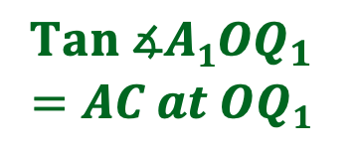


$$Since at A1,$$
$$Tan ∡A1OQ_{1 }>Tan ∡A1T1Q_{1 }$$
$$AC>MC$$
TC
Cost
A₁
t₁
$$Tan ∡A1OQ_{1}$$
$$=AC at OQ1$$
$$Tan ∡A1T_{1}Q_{1}=MC at OQ1$$
T₁
O
Q₁
Qty

Slide 19



Cost
$$Since at A3,$$
$$Tan ∡A3OQ_{3 }<Tan ∡A3T3Q_{3 }$$
$$AC<MC$$
TC
t₃
A₃
$$Tan ∡A3OQ_{3}$$
$$=AC at OQ3$$
$$Tan ∡A3T_{3}Q_{3} = MC at OQ3$$
O
T₃
Q₃
Qty

Slide 20







Cost
$$Tan ∡AT_{1}Q_{1}=MC at A$$
$$Tan ∡AOQ_{1}=AC at A$$
TC
$$Tan ∡BOQ_{2}=MC at B$$
t3
$$Tan ∡BOQ_{2}=AC at B$$
$$∴OQ_{2}=Optimum Qty$$
C
t2
t1
B
$$Tan ∡CT_{2}Q_{3}=MC at C$$
A
$$Tan ∡COQ_{3}=AC at C$$
T1
O
T2
Q1
Q2
Q3
Qty

Slide 21
Measuring AC & MC via The TC curve and Calculus

Slide 22
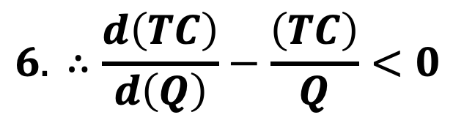
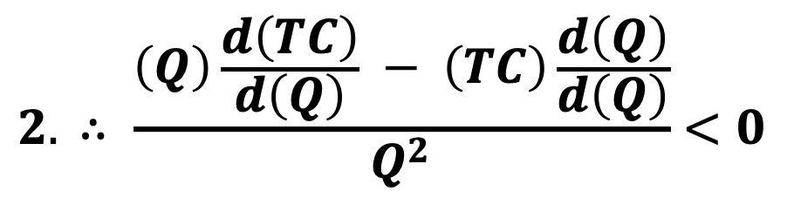
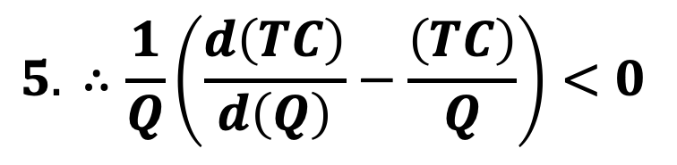
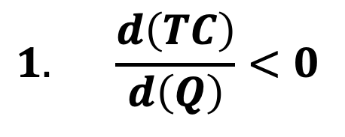
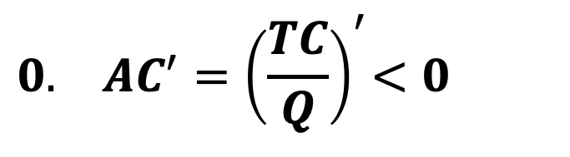
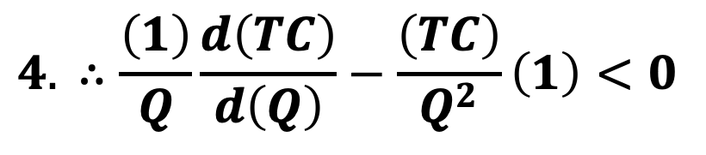
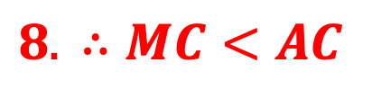
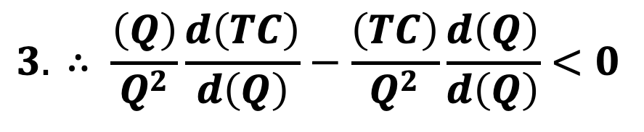
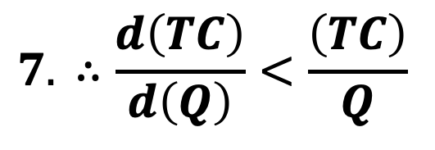
Relationship between AC and MC
At Pre-Optimum Output (KL)
AC, MC
MC
AC
K
P
L
Qty
$$0.{ AC^{′}=\left(\frac{TC}{Q}\right)}^{′}<0$$
$$1. \frac{d\left(TC\right)}{d\left(Q\right)}<0$$
$$2. ∴ \frac{\left(Q\right)\frac{d\left(TC\right)}{d\left(Q\right)} − \left(TC\right)\frac{d\left(Q\right)}{d\left(Q\right)}}{Q^{2}}<0$$
$$3. ∴ \frac{\left(Q\right)}{Q^{2}}\frac{d\left(TC\right)}{d\left(Q\right)}−\frac{\left(TC\right)}{Q^{2}}\frac{d\left(Q\right)}{d\left(Q\right)}<0$$
$$4. ∴\frac{\left(1\right)}{Q}\frac{d\left(TC\right)}{d\left(Q\right)}−\frac{\left(TC\right)}{Q^{2}}\left(1\right)<0$$
$$5. ∴\frac{1}{Q}\left(\frac{d\left(TC\right)}{d\left(Q\right)}−\frac{\left(TC\right)}{Q}\right)<0$$
$$6. ∴\frac{d\left(TC\right)}{d\left(Q\right)}−\frac{\left(TC\right)}{Q}<0$$
$$7. ∴\frac{d\left(TC\right)}{d\left(Q\right)}<\frac{\left(TC\right)}{Q}$$
$$8. ∴MC<AC$$

Slide 23
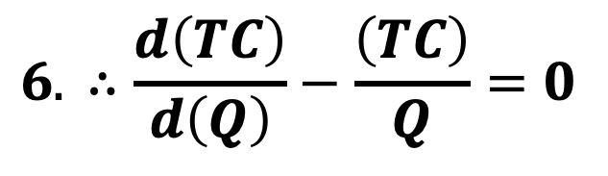
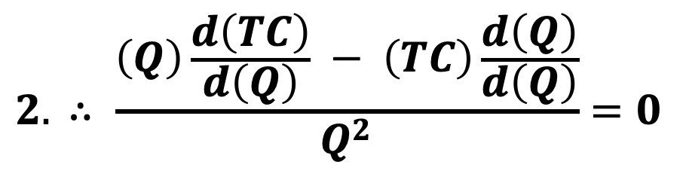
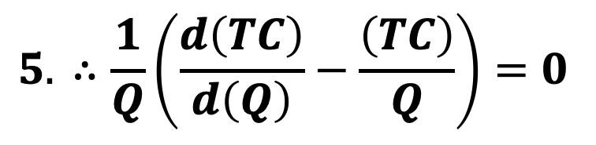
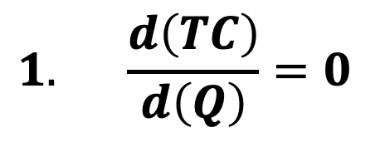
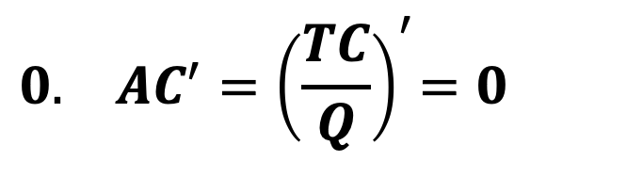
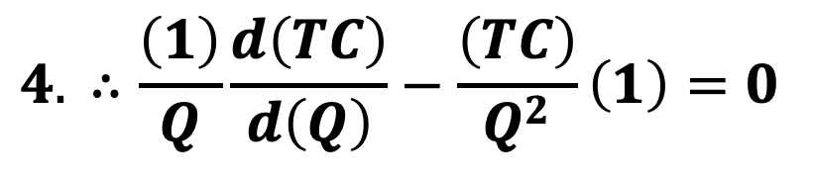
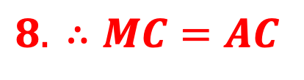
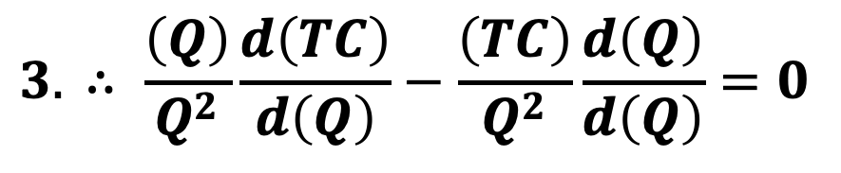
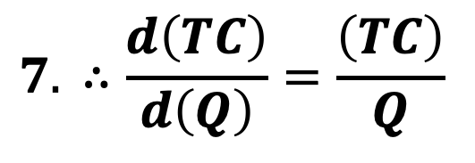
Relationship between AC and MC
At Optimum Output (point L)
AC, MC
MC
AC
K
P
L
Qty
$$0.{ AC^{′}=\left(\frac{TC}{Q}\right)}^{′}=0$$
$$1. \frac{d\left(TC\right)}{d\left(Q\right)}=0$$
$$2. ∴ \frac{\left(Q\right)\frac{d\left(TC\right)}{d\left(Q\right)} − \left(TC\right)\frac{d\left(Q\right)}{d\left(Q\right)}}{Q^{2}}=0$$
$$3. ∴ \frac{\left(Q\right)}{Q^{2}}\frac{d\left(TC\right)}{d\left(Q\right)}−\frac{\left(TC\right)}{Q^{2}}\frac{d\left(Q\right)}{d\left(Q\right)}=0$$
$$4. ∴\frac{\left(1\right)}{Q}\frac{d\left(TC\right)}{d\left(Q\right)}−\frac{\left(TC\right)}{Q^{2}}\left(1\right)=0$$
$$5. ∴\frac{1}{Q}\left(\frac{d\left(TC\right)}{d\left(Q\right)}−\frac{\left(TC\right)}{Q}\right)=0$$
$$6. ∴\frac{d\left(TC\right)}{d\left(Q\right)}−\frac{\left(TC\right)}{Q}=0$$
$$7. ∴\frac{d\left(TC\right)}{d\left(Q\right)}=\frac{\left(TC\right)}{Q}$$
$$8. ∴MC=AC$$

Slide 24
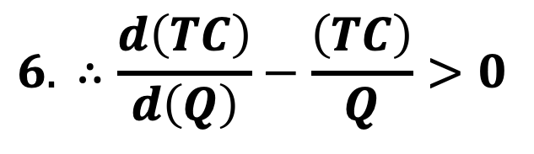
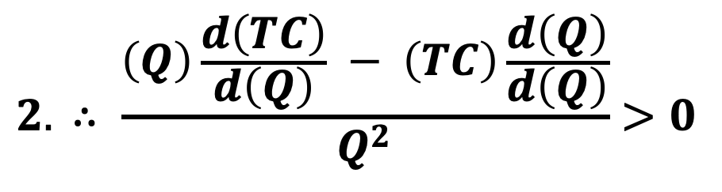
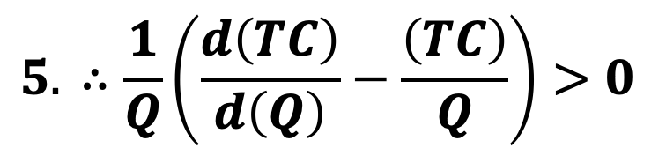
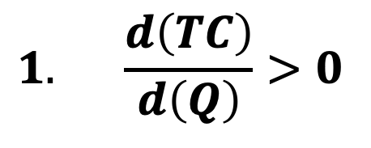
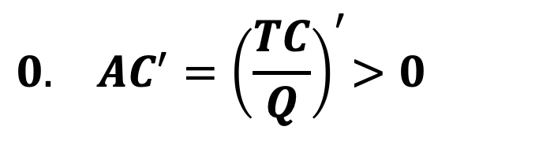
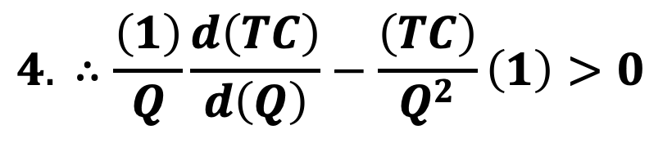
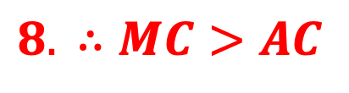
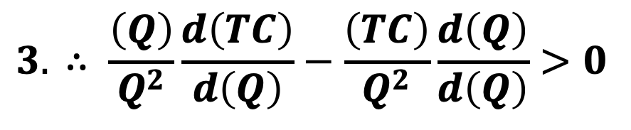
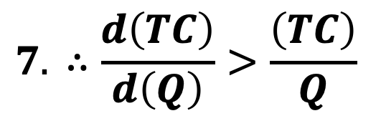
Relationship between AC and MC
At Post-Optimum Output (LP)
AC, MC
MC
AC
K
P
L
Qty
$$0.{ AC^{′}=\left(\frac{TC}{Q}\right)}^{′}>0$$
$$1. \frac{d\left(TC\right)}{d\left(Q\right)}>0$$
$$2. ∴ \frac{\left(Q\right)\frac{d\left(TC\right)}{d\left(Q\right)} − \left(TC\right)\frac{d\left(Q\right)}{d\left(Q\right)}}{Q^{2}}>0$$
$$3. ∴ \frac{\left(Q\right)}{Q^{2}}\frac{d\left(TC\right)}{d\left(Q\right)}−\frac{\left(TC\right)}{Q^{2}}\frac{d\left(Q\right)}{d\left(Q\right)}>0$$
$$4. ∴\frac{\left(1\right)}{Q}\frac{d\left(TC\right)}{d\left(Q\right)}−\frac{\left(TC\right)}{Q^{2}}\left(1\right)>0$$
$$5. ∴\frac{1}{Q}\left(\frac{d\left(TC\right)}{d\left(Q\right)}−\frac{\left(TC\right)}{Q}\right)>0$$
$$6. ∴\frac{d\left(TC\right)}{d\left(Q\right)}−\frac{\left(TC\right)}{Q}>0$$
$$7. ∴\frac{d\left(TC\right)}{d\left(Q\right)}>\frac{\left(TC\right)}{Q}$$
$$8. ∴MC>AC$$

Slide 25
MC
Excess Capacity or Idle Capacity
AC
MC
‘Tragedy’ (?)
Implies Problems
1. Inflation
AC
2. Unemployment
A1
3. Resource Wastage
‘Strategy’ ?
Implies Planning
L
a. Production Agility
b. Seasonality Compliance
c. Inventory Management
Q1
Q2
Optimal
Output
Qty
Excess Capacity
= OQ2 – OQ1
= Optimum Qty – Actual Qty

Slide 26
C = q³ – q² + 3q + 10
AC = q² – q + 3 + 10/q
AC’ = 2q – 1 - 10/(q²) = 0
AC’ = 2q³ – q² - 10 = 0
2q³ – q² - 10 = 0
Q₁ = 1.8, Q₂ = -0.68, Q₃ = complex Number

Slide 27
Long Run Cost Curve
The LAC is the locus of the operational points of every adopted technology
SACs
LAC
LAC
SAC1
SAC5
SAC2
SAC4
SAC3
The LAC is also called the ‘Envelope Curve’
Qty

Slide 28
LAC
LAC
SACs
SAC1
SAC5
A₁
SAC2
SAC4
SAC3
A
A₂
The LAC is also called the ‘Planning Curve’
Q1
Q2
Qty

Slide 29
LAC
Shape of the LAC
LAC
SACs
IRS
DRS
Qty

Slide 30
Shifting of the LAC
LAC
LAC2
SACs
SAC1
SAC5
LAC1
SAC2
SAC4
SAC3
SAC5*
SAC1*
SAC2*
SAC3*
SAC4*
Qty

Slide 31
Shifting of the LAC
SACs
LAC
LAC2
LAC₁ to LAC₂ due to
External Diseconomies of Scale
LAC1
LAC₂ to LAC₁ due to
External Economies of Scale
Qty

Slide 32
LAC
LAC
SACs
SAC1
SAC5
SAC2
SAC4
SAC3
Long-Term Cost Curve
Segment 5
Qty
Cap
Segment 4
Segment 3
Segment 2
Segment 1
Long-Term Laws of Production
Lab

Slide 33
LAC
LAC
SACs
SAC1
SAC5
SAC2
SAC4
SAC3
How to construct the LAC
Qty

Slide 34
SAC1
SAC5
LAC
LAC
SACs
SAC4
SAC2
SAC3
WRONG LAC
Qty
LAC
LAC
SACs
SAC1
SAC5
SAC2
SAC4
SAC3
CORRECT LAC
Qty

Slide 35
OPPORTUNITY COST - a nuance of cost
G_{Y}
A
M₁
A₁
A₂
M₂
A₃
M₃
B
B₁
B₂
B₃
G_{X}

Slide 36
SHIFTING OF OPPORTUNITY COST CURVE
G_{Y}
G_{Y}
Figure 1
Figure 2
A₁
A₁
A
A
B
B₁
G_{X}
B
B₁
G_{X}
G_{Y}
G_{Y}
Figure 3
A₁
Figure 4
A
A
B₁
B
G_{X}
B₁
G_{X}
B

Slide 37
Optimization Problems

Slide 38
Optimization Problem via LAGRANGE MULTIPLIER
If the technique of constrained optimization is not feasible because of the constraints being too many or complex, the Lagrangian Multiplier is used
For this the Lagrangian function must be constructed by combining:
The function to be optimized (i.e., either minimized or maximized)
With the given constraints
This Lagrangian equation is constructed so that:
When this Lagrangian equation is optimized, the original function that must be optimized is in fact optimized
2. All the given constraints are also satisfied in this optimization process

Slide 39
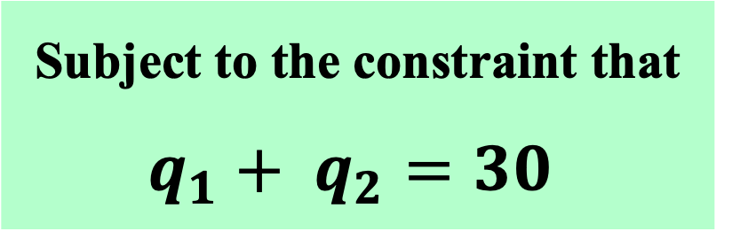
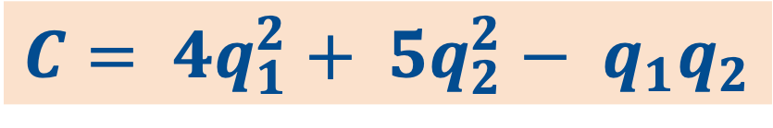
Illustration No. 1:
A firm wants to minimize its Total Cost ( C )
$${C= 4q}_{1}^{2}+ {5q}_{2}^{2}− q_{1}q_{2}$$
Subject to the constraint that
$$q_{1}+ q_{2}=30$$
Guide this firm as to how it should employ the two inputs to fulfil this objective under the given constraint

Slide 40
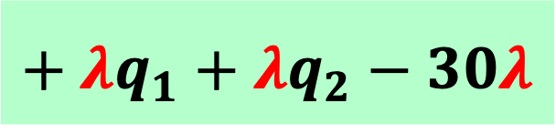
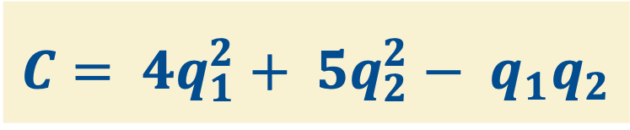
Solution (Illustration No. 1):
Step 1: Rewrite the constraint $q_{1}+ q_{2}=30$ as
$$q_{1}+ q_{2}−30 =0$$
Step 2: Multiply the restructured Constraint equation with $λ$:
Where $λ$ (Lamda) is an unknown factor
$$λ\left(q_{1}+ q_{2}−30\right)=λq_{1}+ λq_{2}−30λ=0$$
Step 3: Form the Lagrangian function
by adding to the Cost Function,
the restructured Constraint equation :
$${C= 4q}_{1}^{2}+ {5q}_{2}^{2}− q_{1}q_{2}$$
$$+ λq_{1}+λq_{2}−30λ$$

Slide 41
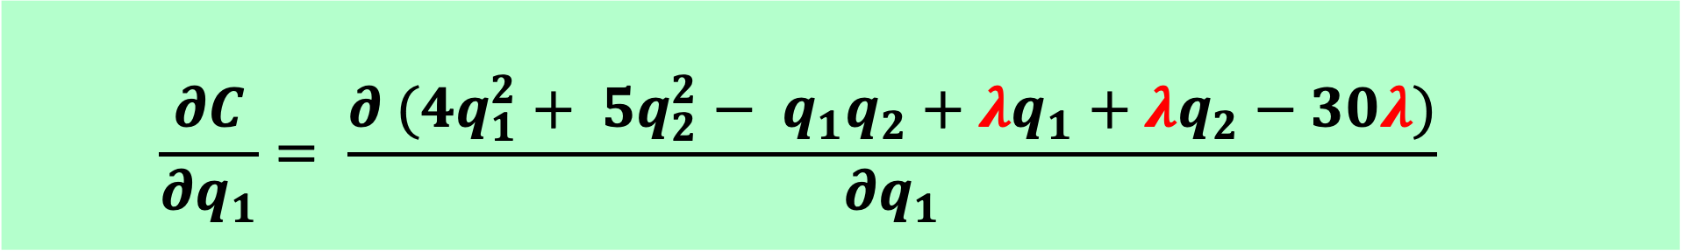
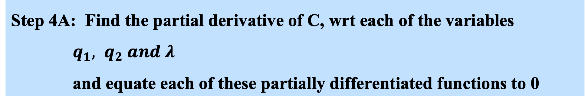
Solution (Illustration No. 1) Contd.:
Step 4A: Find the partial derivative of C, wrt each of the variables
$q_{1}, q_{2} and λ$
and equate each of these partially differentiated functions to 0
$$\frac{∂C}{∂q_{1}}= \frac{∂{ (4q}_{1}^{2}+ {5q}_{2}^{2}− q_{1}q_{2}+λq_{1}+λq_{2}−30λ)}{∂q_{1}}$$
$$= {8q}_{1}− q_{2}+λ=0$$
$Hence, λ={−8q}_{1}+ q_{2} …eq 1$

Slide 42
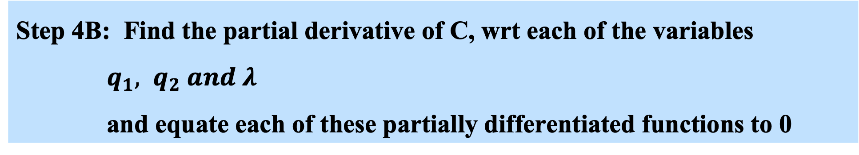

Solution (Illustration No. 1) Contd.:
Step 4B: Find the partial derivative of C, wrt each of the variables
$q_{1}, q_{2} and λ$
and equate each of these partially differentiated functions to 0
$$\frac{∂C}{∂q_{2}}= \frac{∂{ (4q}_{1}^{2}+ {5q}_{2}^{2}− q_{1}q_{2}+λq_{1}+λq_{2}−30λ)}{∂q_{2}}$$
$$= {10q}_{2}− q_{1}+λ=0$$
$Hence, λ=+ q_{1}−{10q}_{2} …eq 2$

Slide 43


Solution (Illustration No. 1) Contd.:
Step 4C: Find the partial derivative of C, wrt each of the variables
$q_{1}, q_{2} and λ$
and equate each of these partially differentiated functions to 0
$$\frac{∂C}{∂λ}= \frac{∂{ (4q}_{1}^{2}+ {5q}_{2}^{2}− q_{1}q_{2}+λq_{1}+λq_{2}−30λ)}{∂λ}$$
$$= q_{1}+ q_{2}−30=0$$
$Hence q_{1}+{ q}_{2 }=30 …eq 3$

Slide 44













Solution (Illustration No. 1) Contd.:
From eq 1& eq 2, it follows that:
-${{8q}_{1}+ q_{2}= +q}_{1}− {10q}_{2}$
$Hence, q_{1}= \frac{{11q}_{2}}{9}$ (A)
Substituting this value of q₁ from (A) into eq 3, we can get the value of q₂ as:
$q_{1}+ q_{2}=30$
$$\frac{{11q}_{2}}{9}+ q_{2}=30$$
$${11q}_{2}+ 9q_{2}=270$$
${20q}_{2}=270$
$q_{2}=\frac{270}{20}=13.5$
${ q}_{1}+ 13.5=30$
${ q}_{1}=30−13.5$
${ q}_{1}=16.5$
Hence, optimal values of inputs are:
q₁ = 16.5 units and q₂ = 13.5 units
Minimized cost C is:
${C= 4q}_{1}^{2}+ {5q}_{2}^{2}− q_{1}q_{2}$
$$4{(16.5)}^{2}+ 5{(13.5)}^{2}− \left(16.5\right)\left(13.5\right)$$
$$= 1777.5$$

Slide 45
Illustration No. 2:
A consumer wants to maximize her / his Utility ( U ), by consuming 2 goods (G₁ and G₂).
The Utility function of this consumer is: $U= {(q}_{1}){(q}_{2})$
The prices of the goods are: P₁ = Rs 4 and P₂ = Rs 10
The consumer’s Budget is Rs 100
Configure for this consumer the quantities of the two goods that she / he should consume to fully maximise utility under the given budget constraint

Slide 46




Solution (Illustration No. 2): Contd.
Step 1A: Construct the budget constraint as
$$4q_{1}+10q_{2}=100$$
Step 1B: Restructure the budget constraint as
$$4q_{1}+10q_{2}−100=0$$
Step 2: Multiply the restructured constraint equation as:
$λ({4q}_{1}+ {10q}_{2}−100) =λ4q_{1}+ λ10q_{2}−100λ$
Where $λ$ is an unknown factor
Step 3: Form the Lagrangian function by adding this the restructured constraint equation to the Utility Function:
$$U= q_{1}q_{2}+λ4q_{1}+λ{10q}_{2}−100λ$$

Slide 47


Solution (Illustration No. 2): Contd.
Step 4A: Find the partial derivative of U, with respect to each of the variables $q_{1}, q_{2} and λ$ and equate each of these partially differentiated functions to 0 (as per the 1st order condition of minimization):
$$\frac{∂U}{∂q_{1}}= \frac{∂(q_{1}q_{2}+4λq_{1}+10λq_{2}−100λ)}{∂q_{1}}$$
$$= q_{2}+4λ=0$$
$Hence, λ=−\frac{q_{2}}{4} …eq 1$

Slide 48


Solution (Illustration No. 2): Contd.
Step 4B: Find the partial derivative of U, with respect to each of the variables $q_{1}, q_{2} and λ$ and equate each of these partially differentiated functions to 0 (as per the 1st order condition of minimization):
$$\frac{∂U}{∂q_{2}}= \frac{∂{(q}_{1}q_{2}+4λq_{1}+10λq_{2}−100λ)}{∂q_{2}}$$
$$= q_{1}+10λ=0$$
$Hence, λ=\frac{− q_{1}}{10} …eq 2$

Slide 49


Solution (Illustration No. 2): Contd.
Step 4C: Find the partial derivative of U, with respect to each of the variables $q_{1}, q_{2} and λ$ and equate each of these partially differentiated functions to 0 (as per the 1st order condition of minimization):
$$\frac{∂U}{∂λ}=\frac{∂{(q}_{1}q_{2}+4λq_{1}+10λq_{2}−100λ)}{∂λ}$$
$$= {4q}_{1}+10q_{2}−100=0$$
$Hence,{4q}_{1}+10q_{2}=100…eq 3$

Slide 50














Solution (Illustration No. 2): Contd.
From eq 1& eq 2
$$\frac{q_{2}}{4}=\frac{q_{1}}{10}$$
$and so q_{1}= \frac{{10q}_{2}}{4}$
Substituting this value of q₁ into eq 3, we can get the value of q₂ as:
${4q}_{1}+10q_{2}=100$
$4×\frac{{10q}_{2}}{4}+ {10q}_{2}=100$
${10q}_{2}+10q_{2}=100$
${20q}_{2}=100$
$q_{2}=\frac{100}{20}=5$
$q_{1}= \frac{{10q}_{2}}{4}$
$q_{1}= \frac{10∗5}{4}$
${ q}_{1}=12.5$
Hence, optimal values of the goods are:
q₁ = 12.5 units and q₂ = 5 units respectively
$$Maximised Utility is$$
$U=(q1)∗(q2$)
$=(12.5)∗(5)$
$=62.5 utils$

